Slide 1

Additional useful features overview

Slide 2
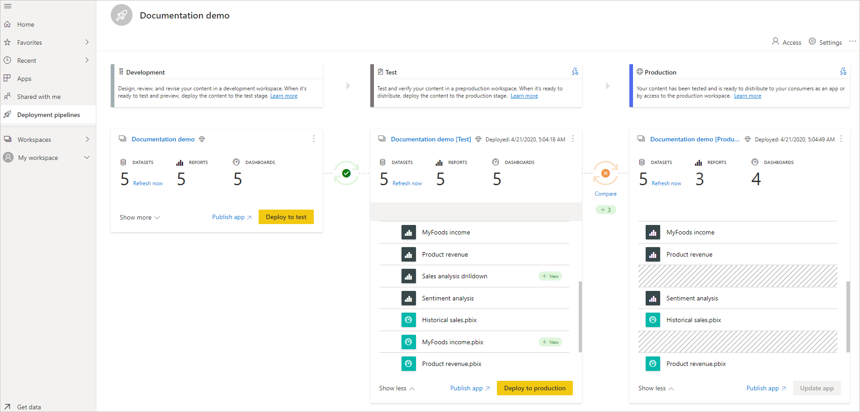
Power BI Deployment Pipelines
The deployment pipelines tool enables BI creators to manage the lifecycle of organizational content.
It's an efficient and reusable tool for creators in an enterprise with Premium capacity. Deployment pipelines enables creators to develop and test Power BI content before the content is consumed by users.
The content types include reports, dashboards, and datasets.

Slide 3
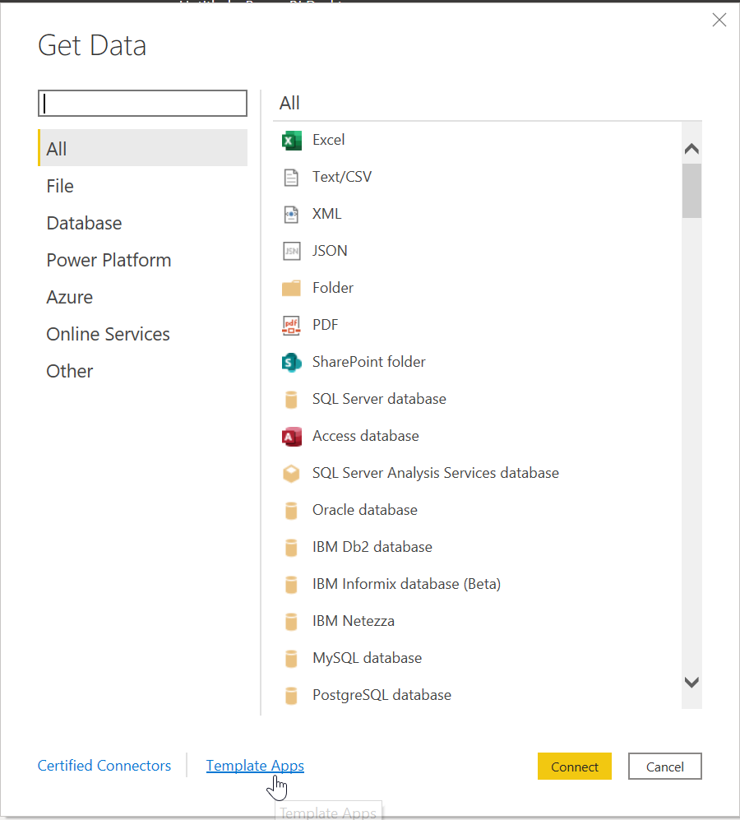
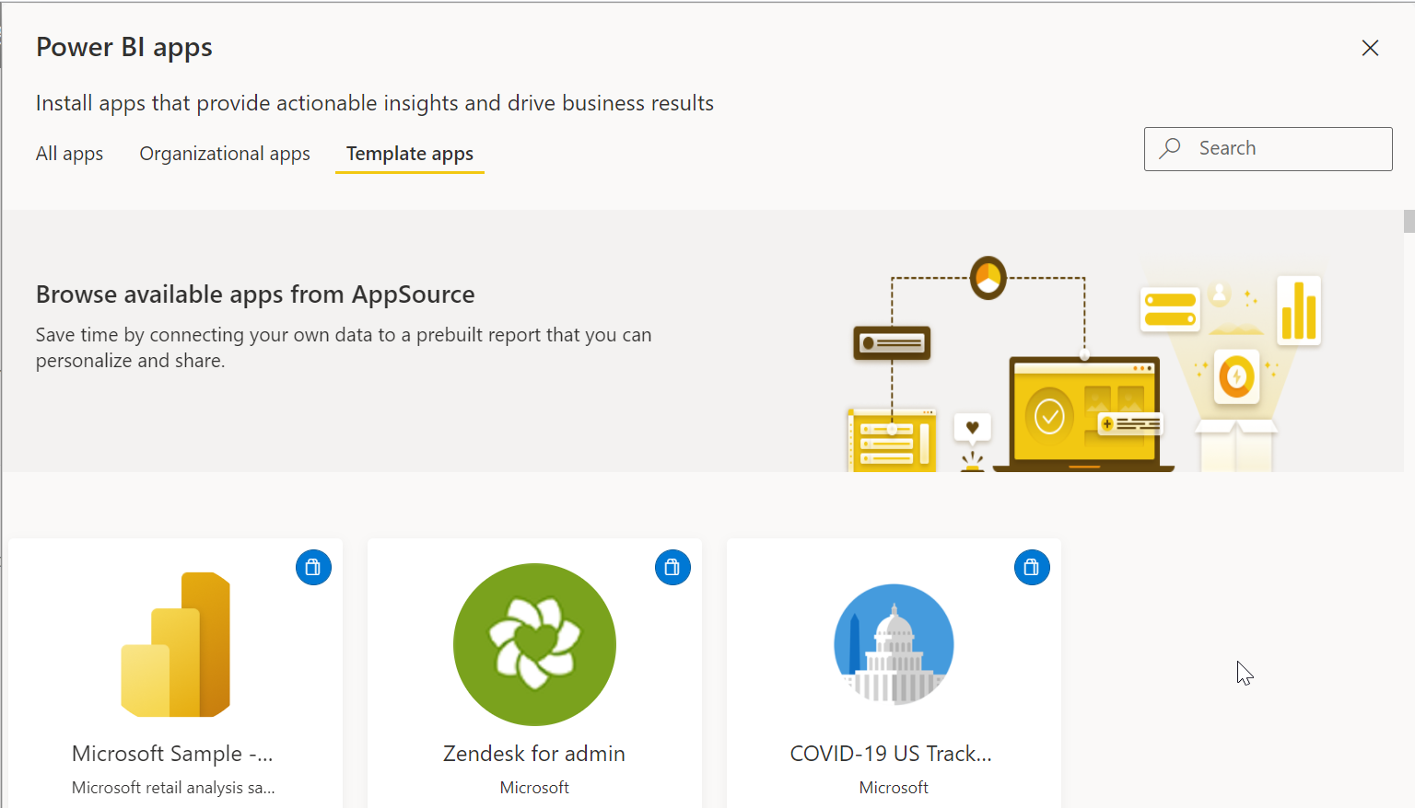
Power BI Templates
Power BI report templates contain the following information from the report from which they were generated:
Report pages, visuals, and other visual elements
The data model definition, including the schema, relationships, measures, and other model definition artifacts
All query definitions, such as queries, Query Parameters, and other query elements
What is not included in templates is the report's data.
Report templates use the file extension .PBIT (compare to Power BI Desktop reports, which use the .PBIX extension).

Slide 4
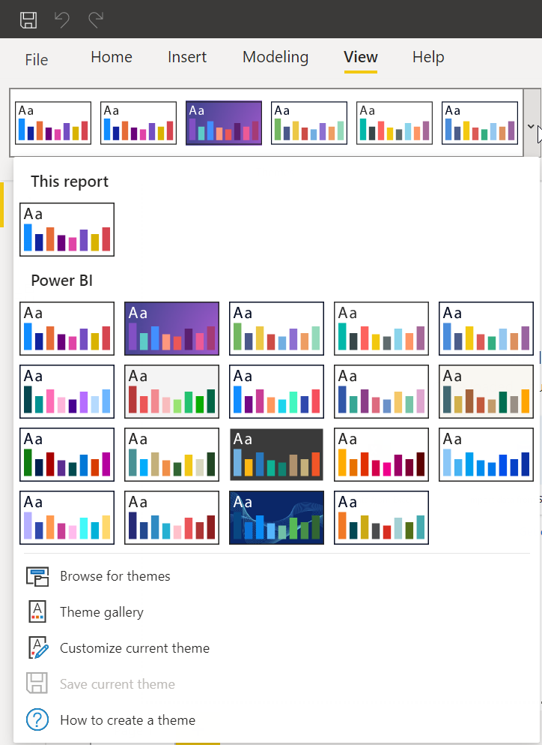
Power BI report themes
With Power BI Desktop report themes, you can apply design changes to your entire report, such as using corporate colors, changing icon sets, or applying new default visual formatting.
When you apply a report theme, all visuals in your report use the colors and formatting from your selected theme as their defaults.

Slide 5
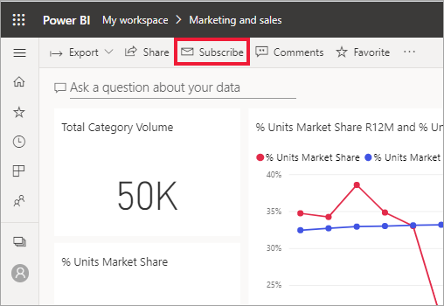
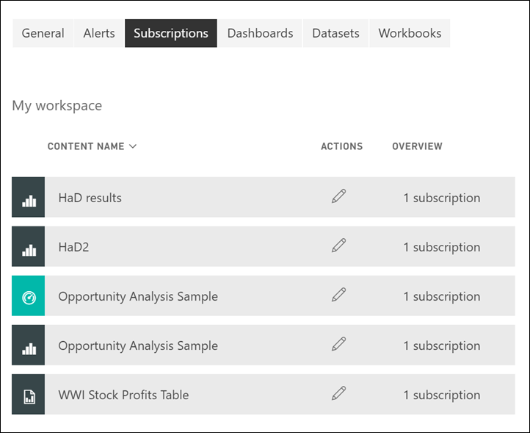
Subscription to emails
Subscription to report pages and dashboards enables Power BI to email a snapshot to your inbox.
Creating a subscription for yourself requires PRO license.
Only you can manage the subscriptions you create.
Select Subscribe again and choose Manage all subscriptions from the bottom left corner. Subscriptions for the current workspace displayed.

Slide 6
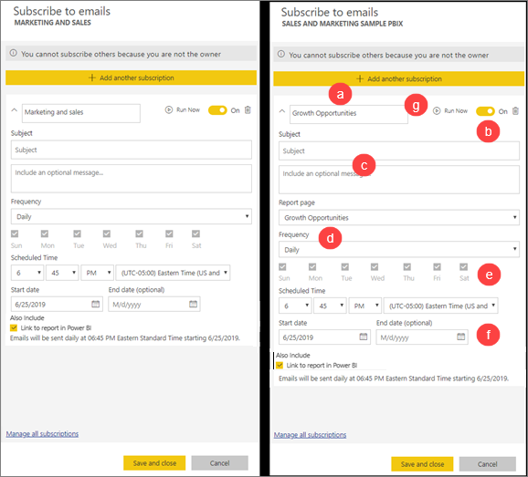
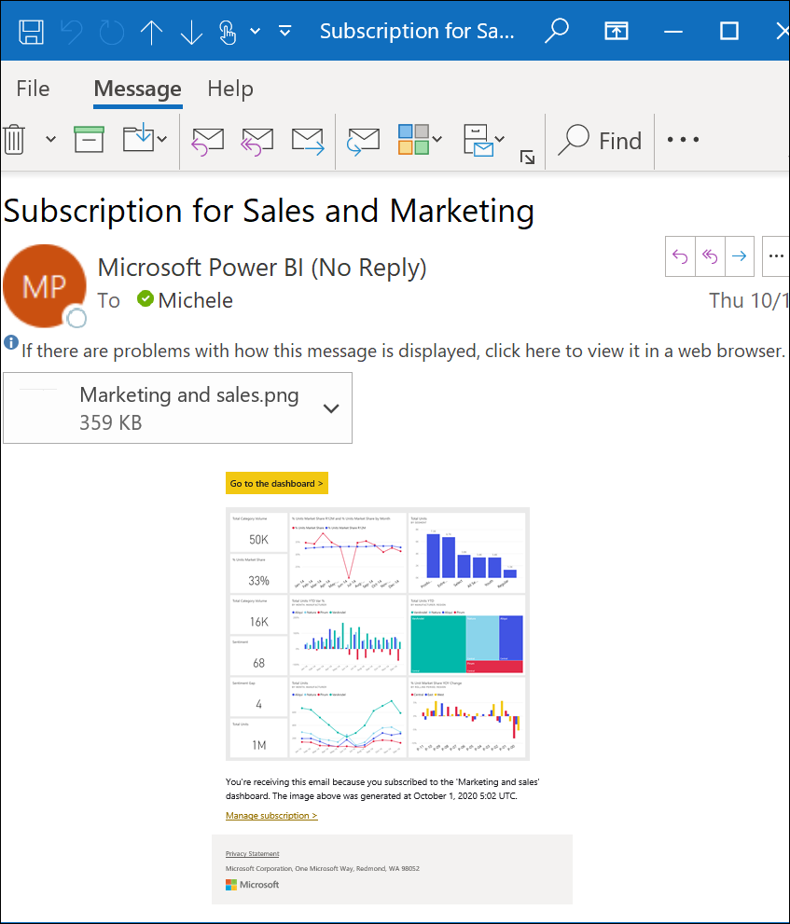
Subscription to emails

Slide 7
Power BI REST APIs
Using Power BI REST API, you can create apps that integrate with Power BI reports, dashboards, and tiles.
With Power BI REST API, it is possible to perform management tasks on Power BI objects like reports, datasets, and workspaces.
For more details see Power BI REST Operation groups

